Slide 1
The Role of Color in Design
Just FACS

Slide 2
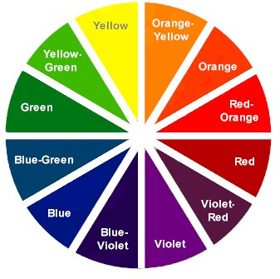

Slide 3
Warm Colors
Warm colors: red, orange, and yellow
Red and orange conveys the most warmth
Warm colors are suitable for areas of high activity such as kitchens and family rooms

Slide 4
Cool Colors
Cool colors: blues and greens
Popular in bedrooms, bathrooms and home offices because of their relaxing effect.

Slide 5
Illusions with Color
Warm colored objects appear closer than cool colored ones.
You can visually enlarge a room by painting the walls a cool color.
High ceilings painted dark colors appear lower and a light color will allow a ceiling to seem higher.
Bold, bright colors make objects stand out.

Slide 6
Components of Color
Pigments- substances that absorb some light rays and reflect others.
Hue is the color feature that makes one color different from others.
Intensity is the brightness or dullness of a color.
Complement color is the color opposite it on the color wheel.
Value is the lightness or darkness of a color.
Adding white to a hue creates a tint.
Ex. Pink is a tint of red.
Adding black to a he creates a shade.
Lowers the value and darkens it.
Adding gray to a color creates a tone.

Slide 7
Color Scheme
A combination of colors selected for a room design in order to create a mood or set a tone.
Provides guidelines for designing successfully with color.
Color schemes look best when one color dominates

Slide 8
Types of Color Schemes
1. Neutral
2. Monochromatic
3. Analogous
4. Complementary
5. Split-Complementary
6. Triad

Slide 9
Neutral
• Neutral color schemes can be easier to live with than with vibrant color schemes.
• Often used as background colors in rooms because they blend well with other colors
• Touches of accent colors are usually added for interest
Notes:
Neutral: black white and gray (sometimes brown and beige)
White: totally absent of color
.give increased visual space
.whitened backgrounds look light, spacious, and farther away
.Hues seem cleaner and crisper when surrounded by white
Black: mixture of all colors
.sharpens and adds richness to the hues placed next to it
.used generously may create a dramatic and theatrical setting
.Accents give richness
Gray: combination of black and white
.warm grays–welcoming and comforting
.cool grays–tend to be cold and uninviting
Browns: mixing several colors on the color wheel or neutralizing orange
.Often introduced through stained woods
.Does not need to match as long as they harmonize
.If used in large amounts can create an oppressive or cave-like coziness

Slide 14
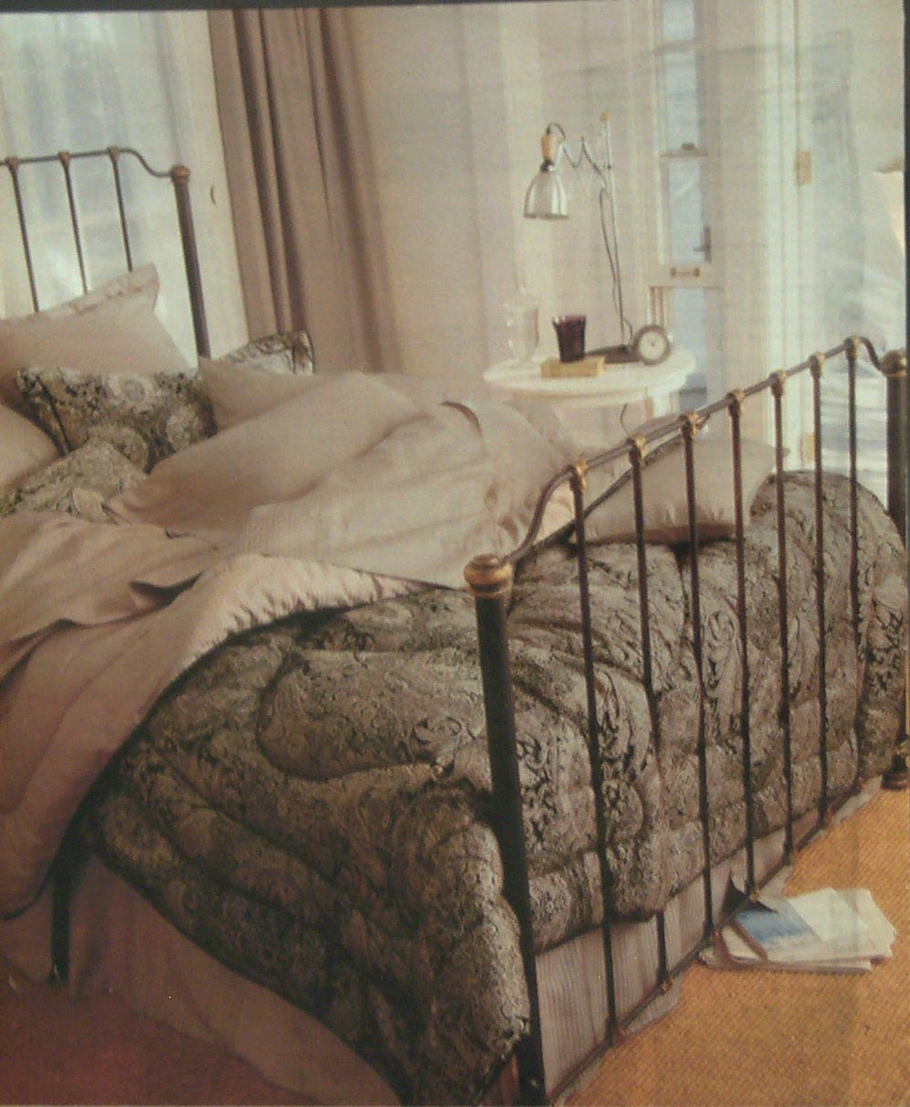

Slide 16
Monochromatic
Tints and shades of one color on the color wheel
Notes:
Monochromatic: tints and shades of one color on the color wheel
.Simplest color harmony
.Variation is achieved by changing the value and intensity of the hue and bu adding accents of neutral colors.
.Can make a room appear larger and unified

Slide 21
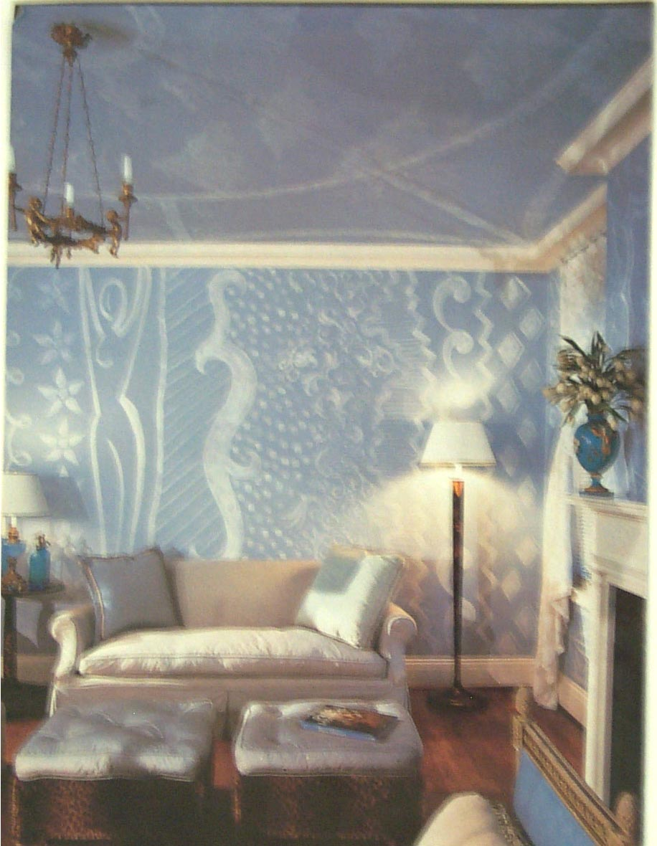

Slide 22
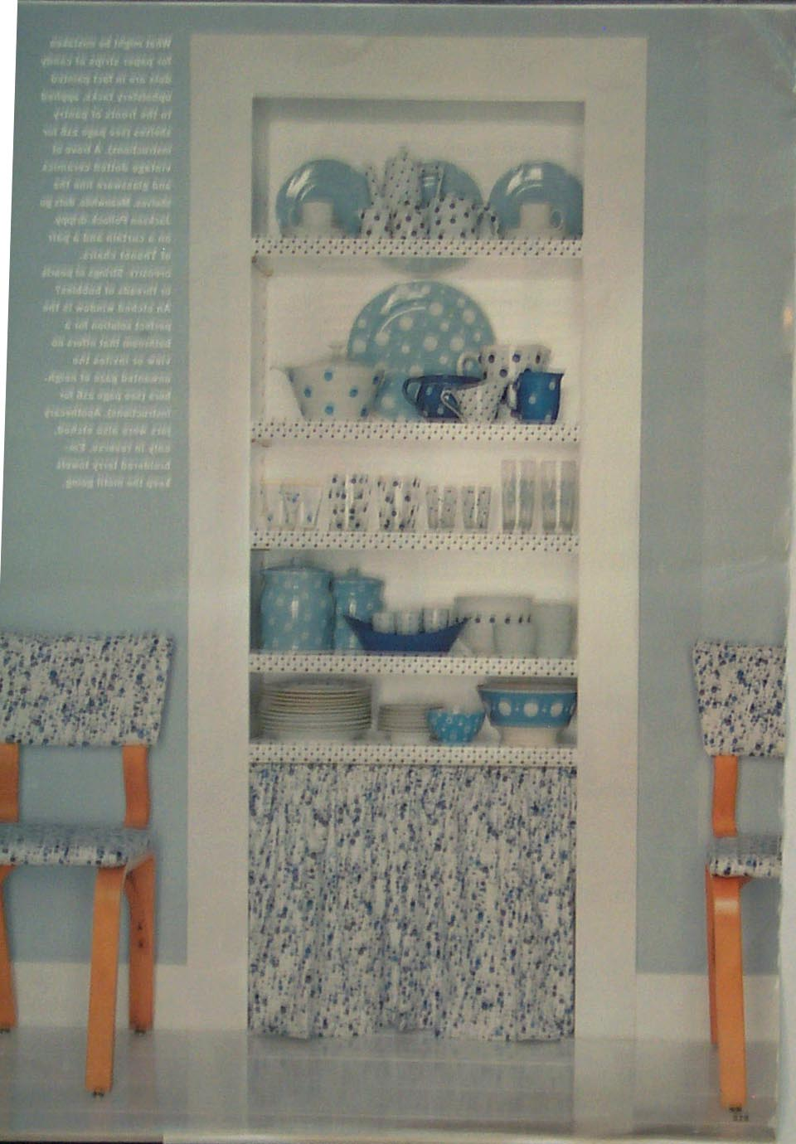

Slide 24
Analogous
3 to 5 hues next to each other on the color wheel
Notes:
Analogous: colors that are next to each other on the color wheel.
.Usually three to five hues
.Tend to look best when one hue is dominant and smaller amounts of the additional hues are used to add interest

Slide 32
Complement
Two colors that are directly opposite each other on the color wheel.
Notes:
Complementary: Two colors that are directly opposite each other on the color wheel.
.Complementary colors make each other look brighter and more intense
.For less contrast, the values and intensities can be varied

Slide 42
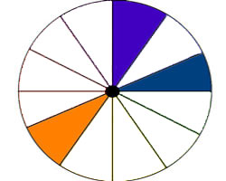
Split Complement
Three colors, they combine one color with the two colors on each side of its complement
Notes:
Split-complementary: Three colors, they combine one color with the two colors on each side of its complement
.i.e. red, yellow-green, and blue-green

Slide 43
Triad
Three colors that are equal distance apart on the color wheel.
Notes:
Triad: three colors that are equal distance apart on the color wheel.
.The three colors can be used in sharp contrast
.By changing value and intensities the contrast can be lessened
.Skill is required to achieve pleasing triad schemes

Slide 52
This is what happens with no color scheme.

Slide 53
Warm Colors
Yellow-green to red
Advancing- make objects look larger or closer than they really are
Notes:
Warm colors: Red, orange and yellow, red being the warmest
.They are considered warm because of the association with sun and fire
.Advancing colors–They make objects look larger or closer than they really are.
.They make a room look warm and cozy

Slide 58
Cool Colors
Green to red-violet
Receding- objects seems larger and farther away
Notes:
Cool Colors: Green, blue, and violet
.Associated with water grass and trees
.Receding colors: objects seem smaller and farther away
.Small room can appear larger if it is decorated in cool colors
.Makes the room feel restful and peaceful.

