Slide 1
Lighting Activity
Directions:
No iPad: Cut out pictures of actual lighting from a catalogue or online, and paste them to the paper.
iPad: Using Google Slides or PicCollage, create a slide for each room using lighting to fit the aesthetic of the room.
BOTH: You will need to show the lighting for the Master Bedroom, Living Room and Dining Room. Label each picture as general, task or decorative.

Slide 2
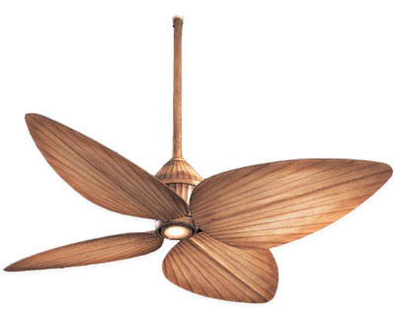
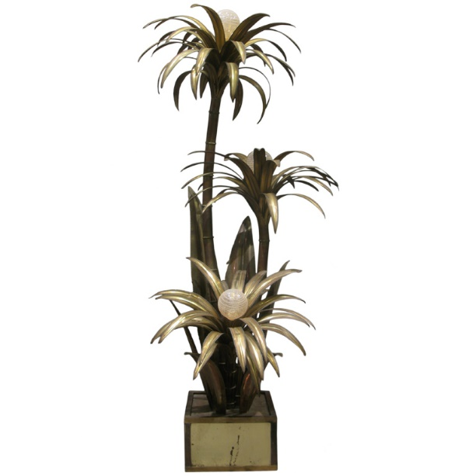
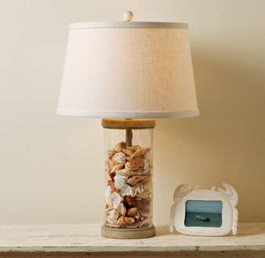
Example: Master Bedroom
General lighting
Decorative Lighting
Task Lighting
Assignment:
Style the General, Task, AND Decorative Lighting for
Bedroom, Dining and Living Room

Slide 3
Share as: Picture from PicCollage or
slide show from Google Slides
IN YOUR INTERIOR DESIGN FOLDER
Share With: FaithElmore@misdmail.net
Subject: Lighting Assignment

