Slide 1
Family Structures
The makeup of a family…

Slide 2
Four Types
Nuclear
Single-Parent
Blended
Extended

Slide 3
Nuclear Family
This family includes: Mom, Dad & AT LEAST one kid!
ADVANTAGES
2 parents to help raise the child
More money (maybe)
And… ?
DISADVANTAGES:
??

Slide 4
Single parent
Includes either a mother or father and at least one child.
The parent may be unmarried, or the other parent might be gone due to death or divorce.
DISADVANTAGES:
Little free-time
No spouse to share in problem solving
Less income (often)
ADVANTAGES:
Not as much fighting
Closer parent/child bond

Slide 5
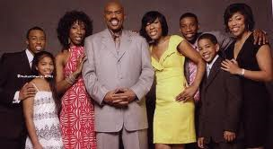
BLENDED FAMILY
Formed when a single parent marries another person , who may or may not be a parent as well.
To the child, the new parent is the STEP-Parent
THINK STEEEEEP!
Adoption
ADVANTAGES:
more money
New friends
??
DISADVANTAGES:
Less space
New rules
???

Slide 6
EXTENDED FAMILY
Includes relatives other than a parent or child who live with them.
A grandparent may live with a nuclear family.
An aunt or uncle may live with a single parent family.
ADVANTAGES:
DISADVANTAGES:

