Slide 1
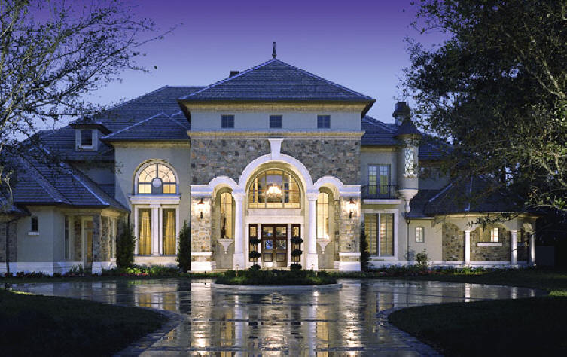
The Elements of Design
Just FACS

Slide 2
Elements for Success
The guidelines used to create pleasing designs are called the elements and principles of design.
The elements of design include:
Space
Line
Form
Texture
Color

Slide 3
Space
Space is the 3 dimensional expanse that a designer is working with.
Different sized spaces convey a range of feelings.
Large, open spaces give people a feeling of freedom and luxury.
Too much open space can make people feel lonely and uncomfortable.
Rooms with high ceilings or too few furnishings can have this effect as well.
Empty parts of room may look larger than smaller areas containing furniture.
Crowded spaces with too much furniture may make you feel confined.
On the other hand, you may feel snug and secure.

Slide 4
Describe the spacing in this picture?

Slide 5
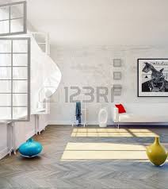

Slide 6
Arranging Space
Two general choices
Fill the space or leave much of it empty.
To make a smaller space appear larger, keep as much open space as possible.
You might also install mirrors to visually enlarge a room.
Choose dual purpose furniture
A shelf unit with cabinets, a seat with storage,
For large space, divide the room into different areas.
By arranging furniture in small clusters and using area rugs to visually divide a large room.

Slide 7
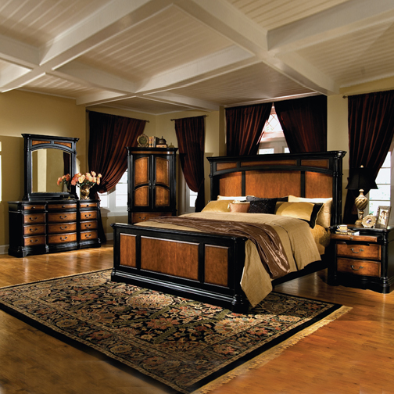
What are your feelings about this space?

Slide 8
Line
Line outlines form and conveys a sense of movement or direction.
Lines can be used to convey a sense of strength, serenity, gracefulness, or action.
All lines are either straight or curved and are placed in a direction, vertical, horizontal, or diagonal.
Vertical lines can convey strength and stability
(pinstriped suit)
A horizontal line may suggest rest.
Diagonal or zigzag lines evoke excitement and movement.
Curved lines have a graceful and delicate effect.

Slide 9
What types of lines do you see here?

Slide 10
Creating Effects with Line
A variety of lines is desirable in a room design.
When people see a line, their eyes tend to follow it.
Line adds height (such as homes with tall windows)
Low sofas can draw your gaze around the room and create the illusion of greater width.
By aligning the tops of picture frames you can create the effect of a continuous line.

Slide 11
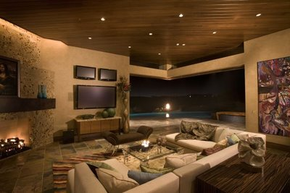
Describe the line used in this picture.

Slide 12
Form
Form describes the shape and structure of solid objects.
Form may be 2 or 3 dimensional.
2 dimensional would be walls and rugs (usually contain little or no depth)
3 dimensional would be chairs and other furniture
Large heavy objects such as pianos or sofas give a feeling of stability.
Their massive appearance adds a solid feeling to the room.
Placing several small objects together will create stability as well (such as 2 chairs and a table grouped together)
Designers are usually more concerned with apparent weight rather than actual weight.
Light colors pair with other light colors equal a lightness
Light colors paired with dark colors may add weight.

Slide 13
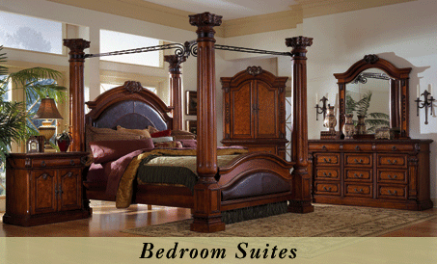
Which room appears to have more weight?

Slide 14
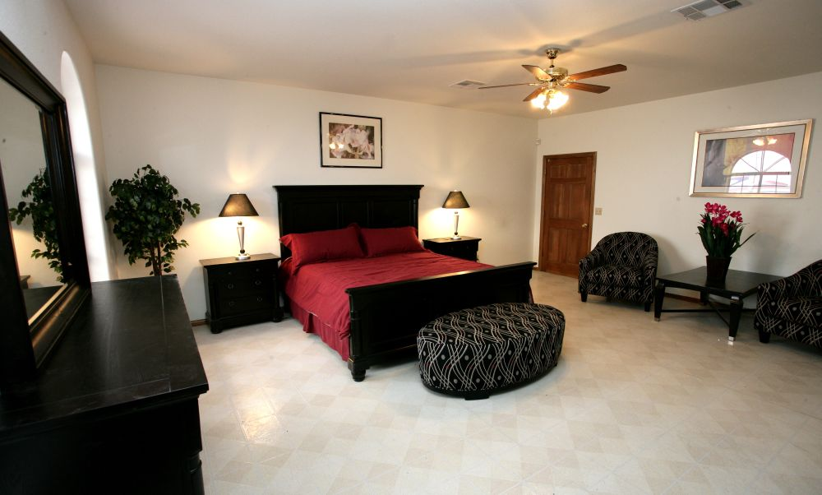
Harmonious Design
Harmonious design is a design in which every item fits well with the others.
Notes:
What is the harmonious factor in this room?

Slide 15
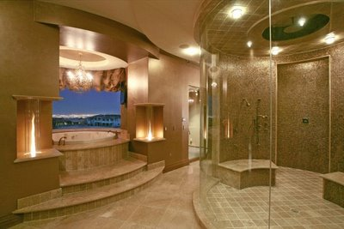
Texture
An object’s texture is the appearance or feel of its surface.
Most times you can tell the texture of the object before you touch it; however some textures can fool the eye.
Wall paper can be made to look rough but have a smooth feel to it.

Slide 16
Special Effects with Texture
Texture can influence the way people feel in a room.
Plush carpet and furniture covered with soft fabric provide a sense of comfort.
Nubby, rough materials convey a feeling of ruggedness and stability.
Smooth velvets and heavy brocades suggest luxury.
Glass, metal and stone give a feeling a coolness.
Texture can also affect apparent size.
Soft silky fabric on a couch may seem smaller than rough and ragged fabric on a couch.
Smooth textures reflect light and rough textures absorb light.

Slide 17
Color
Color is the most significant element of design.
It’s possible to set a mood or create an illusion with color.
You can even make warm rooms feel cool and cool rooms feel warm with color.
Notes:
Color will be discussed in more detail in another presentation.

Slide 18
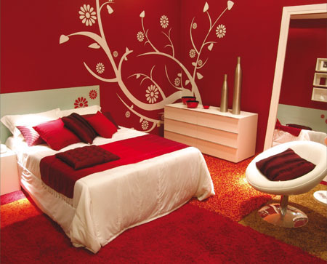
What type of feeling do you get from this room?
Notes:
Note how the red makes the room feel warm and full of energy which is strange for a bedroom.

