Slide 1
Child Birth
Being prepared.

Slide 2
Prepared Child Birth
Prepared child birth is a method of giving birth in which pain is reduced through the elimination of fear and the use of special conditioning exercises.
Though a woman INSTINCTIVELY knows how to give birth, most find preparation to be helpful in reducing stress.

Slide 3
What’s in a word?
Labor: The process by which the baby gradually moves out of the uterus and into the vagina to be born
Delivery: the actual birth itself!

Slide 4
Who will deliver the baby?
Obstetricians: These doctors specialize in prenatal and post natal care of the mother and baby. They are qualified to handle any emergencies or special situation that may arise.
Licensed midwives: There are two types of licensed midwives.
Nurse-midwife: a registered nurse with advanced training in normal pregnancy and birth.
Lay-midwife: has special training in care of pregnant women and normal deliveries but does not have a nursing degree.

Slide 5
Where will the baby be born?
Until the last century, babies were born at home.
Today most are in hospitals.
Alternative birth centers: separate from any hospital, it has a homelike room for giving birth. These emphasis prepared childbirth and usually offer the kinds of services that are part of family-centered maternity care.

Slide 6
Labor

Slide 7
Beginning of labor
Lightening: the baby settles deep into the mother’s pelvis preparing for his or her journey into the world. May be days or weeks before labor.
“show” or “bloody show” or “mucus plug”: throughout the pregnancy a plug of mucus seal the cervix, the lower part of the uterus. This mucus helps prevent bacteria from moving up the vagina into the uterus where is may cause infection. Before birth it liquefies. The woman may notice a few drops of blood. May be a few days before labor.

Slide 8
Signs
Water breaks: a trickle or even gush of warm fluid from the vagina. The membrane holding the amniotic fluid has broken.
Contractions: the tightening and releasing of the muscle of the uterus. When the uterus contracts, it gets shorter and harder like any other muscle.

Slide 9
Stages of Labor

Slide 10
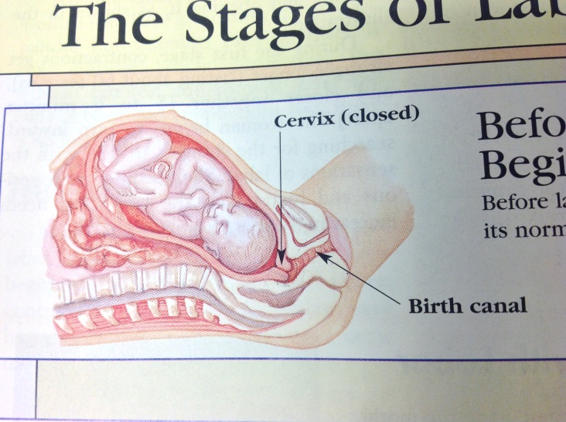
Before Labor
The cervix is normal size and shape.
The uterus is evenly spread around the baby.

Slide 11
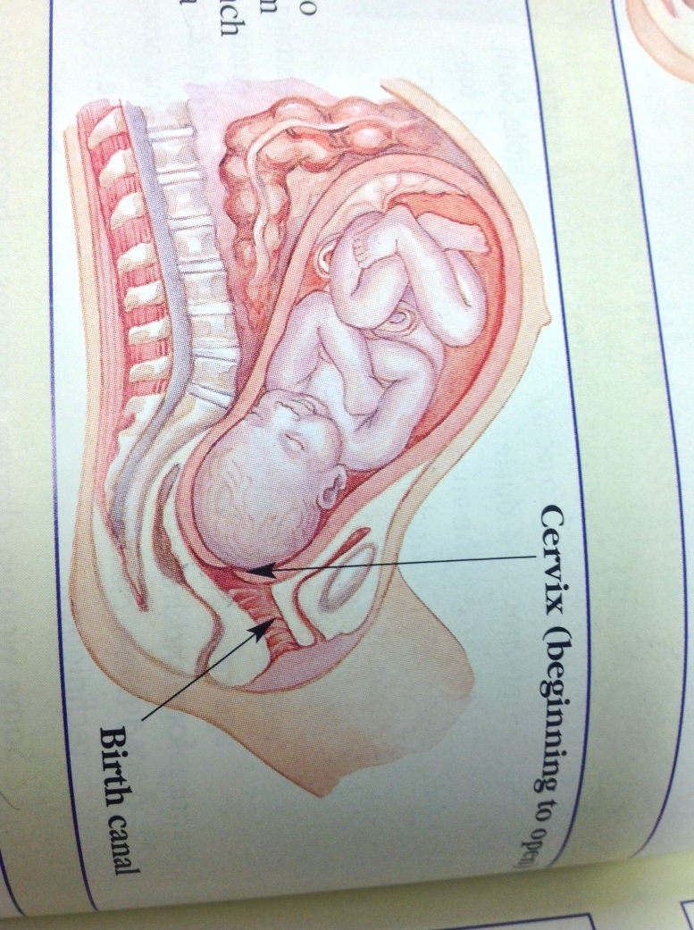
First Stage of Labor
Contractions make the cervix dilate, or widen. The cervix also becomes thinner, changing from its usual thickness of about ¾ inch to become as thin as a sheet of paper. This thinning is called effacement.

Slide 12
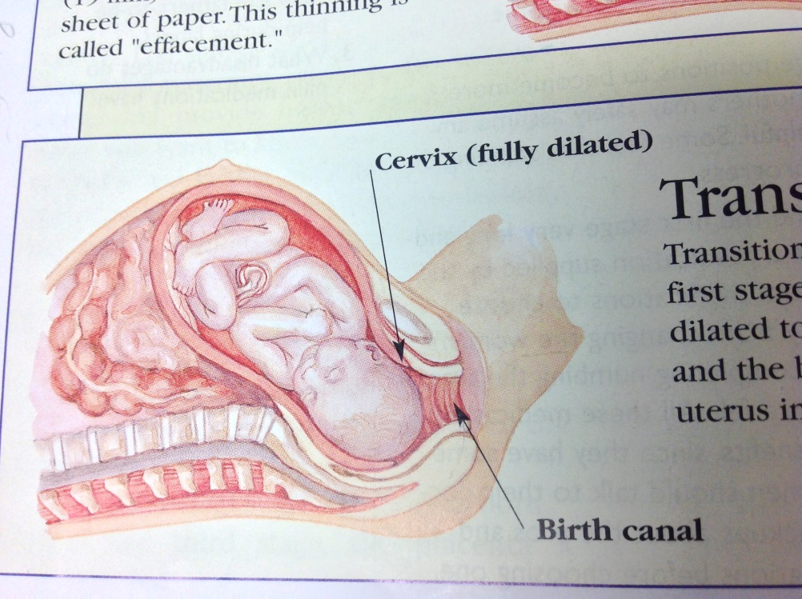
First stage: Transition
This completes the work of the first sate. The cervix becomes fully dilated to a size of 4 inches (10 cm) and the baby’s head slips out of the uterus into the birth canal.

Slide 13
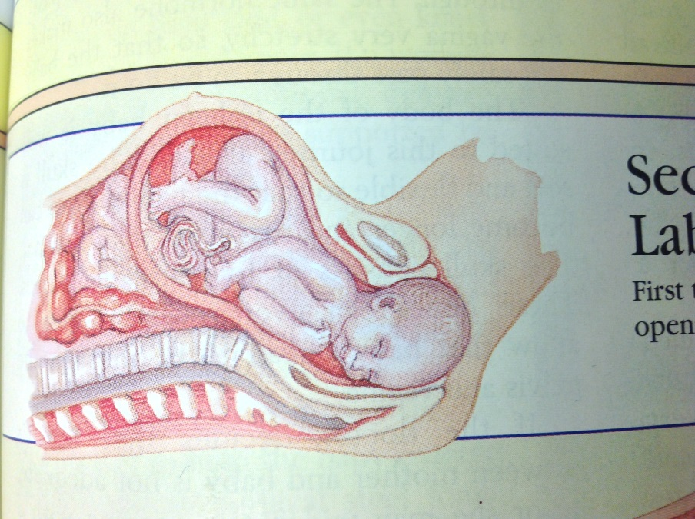
Second Stage of Labor
Crowning
First the top of the head appears at the opening of the birth canal.

Slide 14
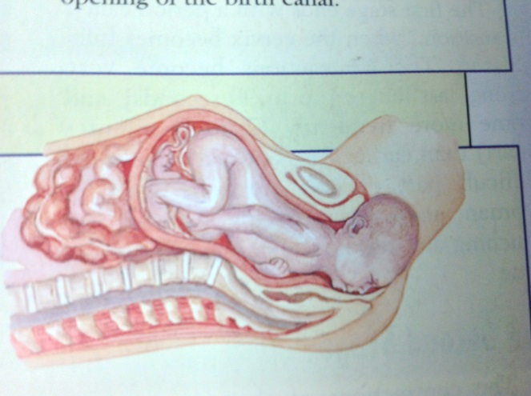
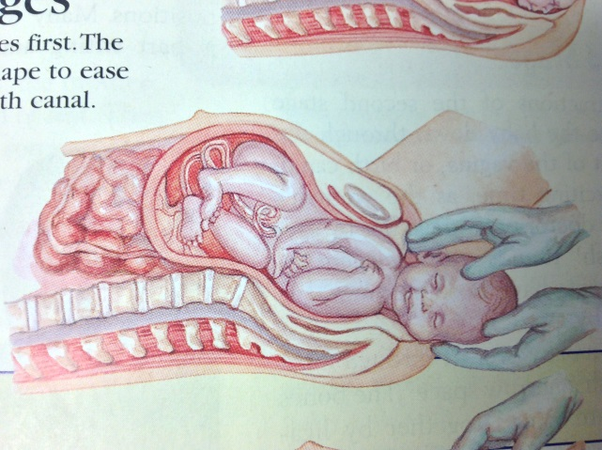
Second Stage of Labor
Head Emerges
The baby’s head emerges first. The head has changed its shape so as to ease passage through the birth canal. After the head, the shoulders follow. Then the rest of the baby.

Slide 15
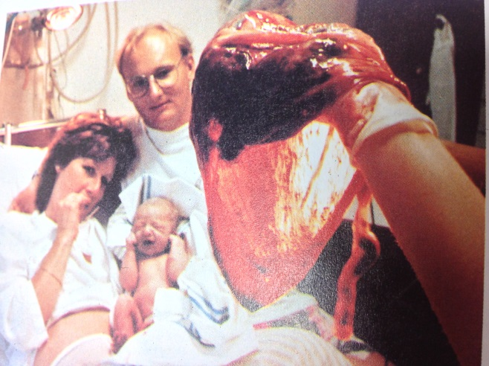
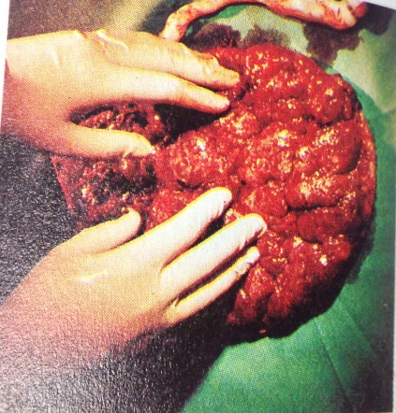
Third Stage of Labor
The woman gives birth to the placenta, no longer needed by the baby.

